Slide 1
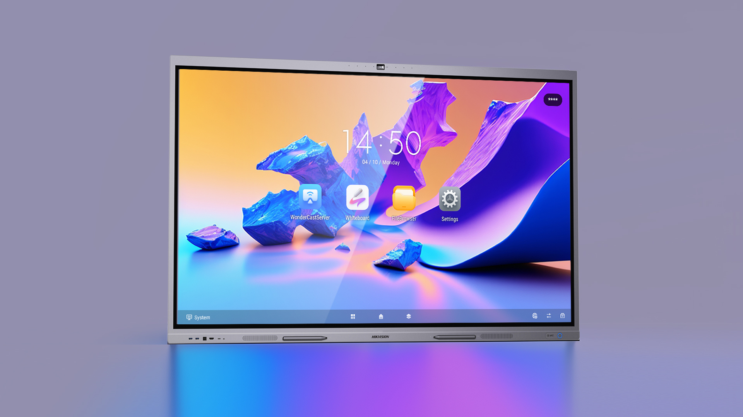

Hikvision D5C Series
Interactive Flat Panel Introduction
Notes:
Hello everyone, I'm XXX from Hikvision. Now I'll give you an introduction and demonstration of Hikvision D5C series interactive flat panel.

Slide 2
01
Overview
CONTENTS
02
Product Introduction
03
Application Scenarios
Notes:
The introduction consists of 3 parts, 1.overview, 2.product introduction, and 3. application scenarios.

Slide 3
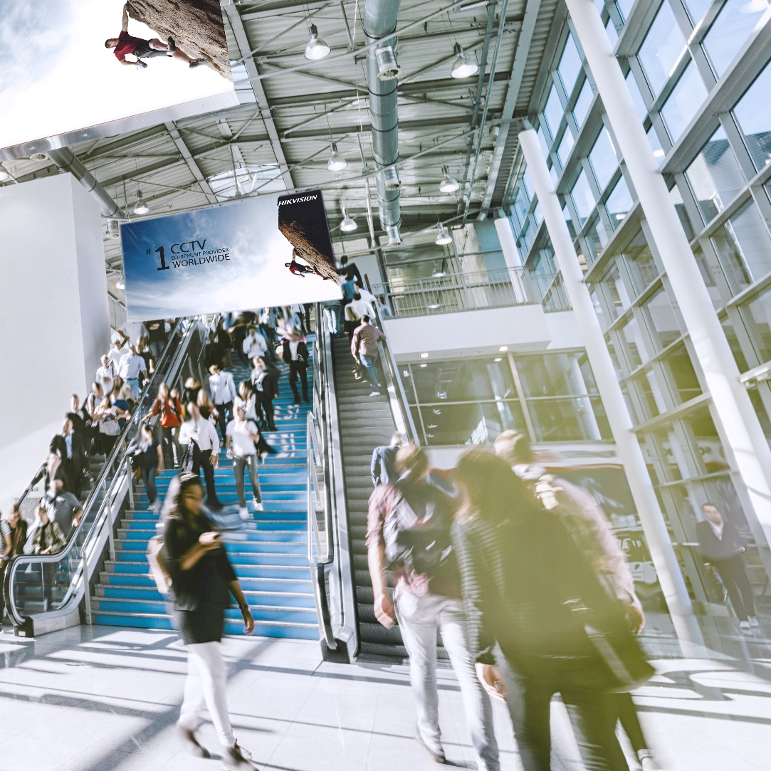
01
Overview

Slide 4

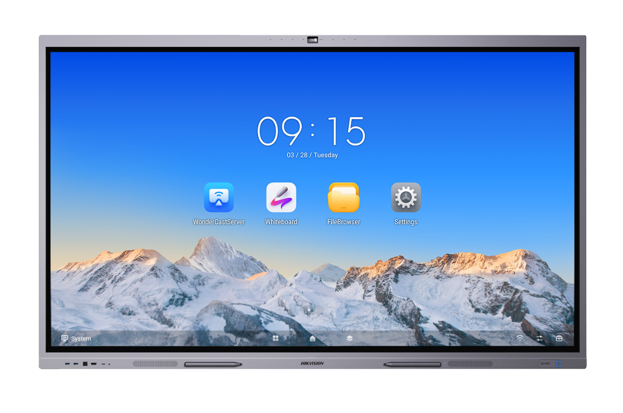
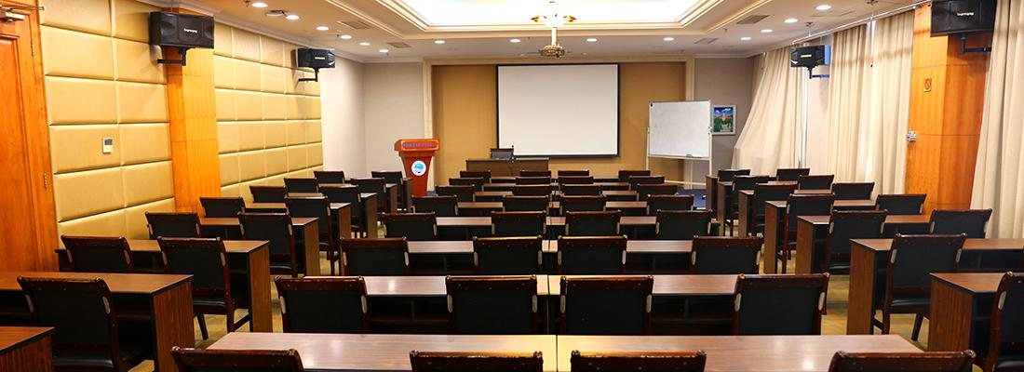
A Better Choice for Your Meeting Room
Loudspeaker
Projector
Curtain
Hikvision interactive flat panel is an all-in-one device supporting wireless projection, smart whiteboard, free annotation, remote meeting, scanning code sharing, etc.
With free App installation capability, it can meet the demands of a variety of business scenarios.
Traditional Meeting Room
Hikvisioni interaktiivne ekraan on kõik-ühes seade, mis toetab juhtmeta projektsiooni, nutikat tahvlit, vaba märkmete tegemist, kaugkoosolekuid, koodi jagamist skännimise teel jne. Tasuta rakenduste installimisvõimalusega saab see vastata mitmesugustele ärilahendustele.
PPT Pen, Eraser, Oily Pen
Whiteboard
Notes:
Hikvision interactive flat panel is an all-in-one device supporting wireless projection, smart whiteboard, free annotation, remote meeting, scanning code sharing, etc.
With free App installation capability, it can meet the demands of a variety of business scenarios.

Slide 5
02
Product Introduction

Slide 6
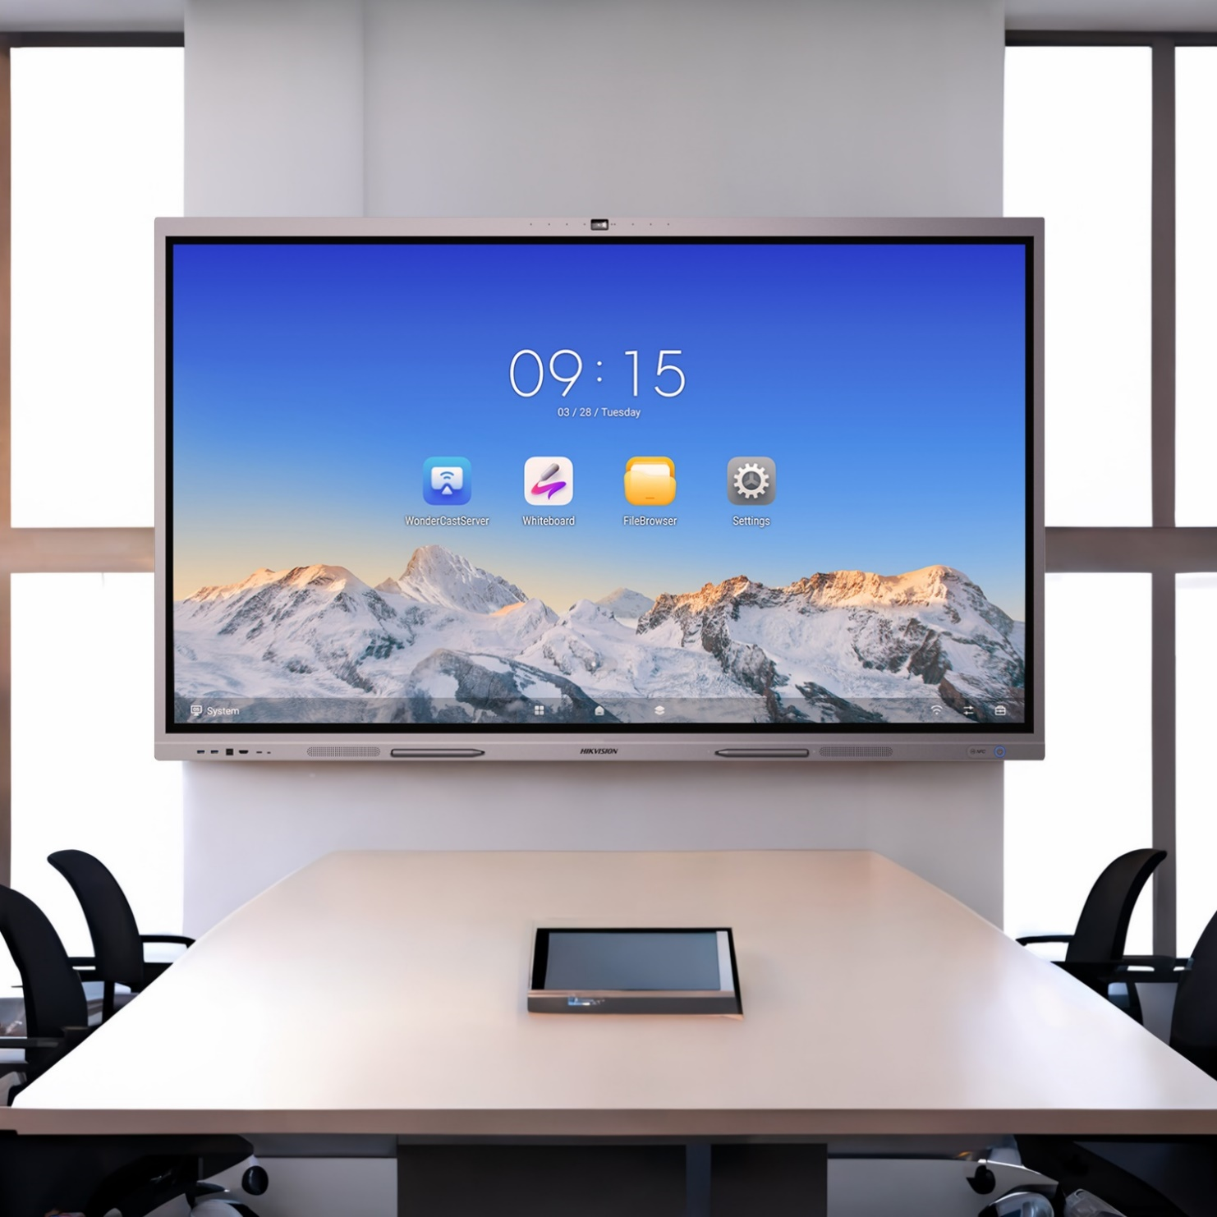




Product Selling Points
Täiustatud riistvara, suurepärane jõudlus
Android 12 süsteem (toetab OTA-d Android 13-le)
8G RAM + 128G ROM
Rohked liidesed sisaldavad HDMI-d, VGA-d, DP-d ja tüüp-C-d
Uus 0S 3.0 kasutajaliides, uus kogemus
Kohandatav alumine menüüriba, lihtne kasutada
Mitmeakna režiim mitme ülesande täitmiseks
Elegantne 4K@60Hz kasutajaliides
Juhtmeta projektsioon, lihtsam kui kunagi varem
- Juhtmevaba projektsioon ja kahepoolne juhtimine
- Mitme terminali samaaegne projektsioon
- Tüüp-C projektsiooni dongel kiireks ekraani edastamiseks
Nutikas tahvel, ideede vaba jagamine
- Mitu inimest samal ajal kirjutamas ja mugavate materjalide importimine
- Koodi skännimise jagamine kohtumiste tulemuste lihtsustamiseks
- Õppetööriistad, mis suurendavad tootlikkust
Kaugkoosolek, suhtle kõikjal
Ühildub peamiste konverentsitarkvaradega
Naudi AI koosolekuid sisseehitatud 4K kaameraga

Slide 7
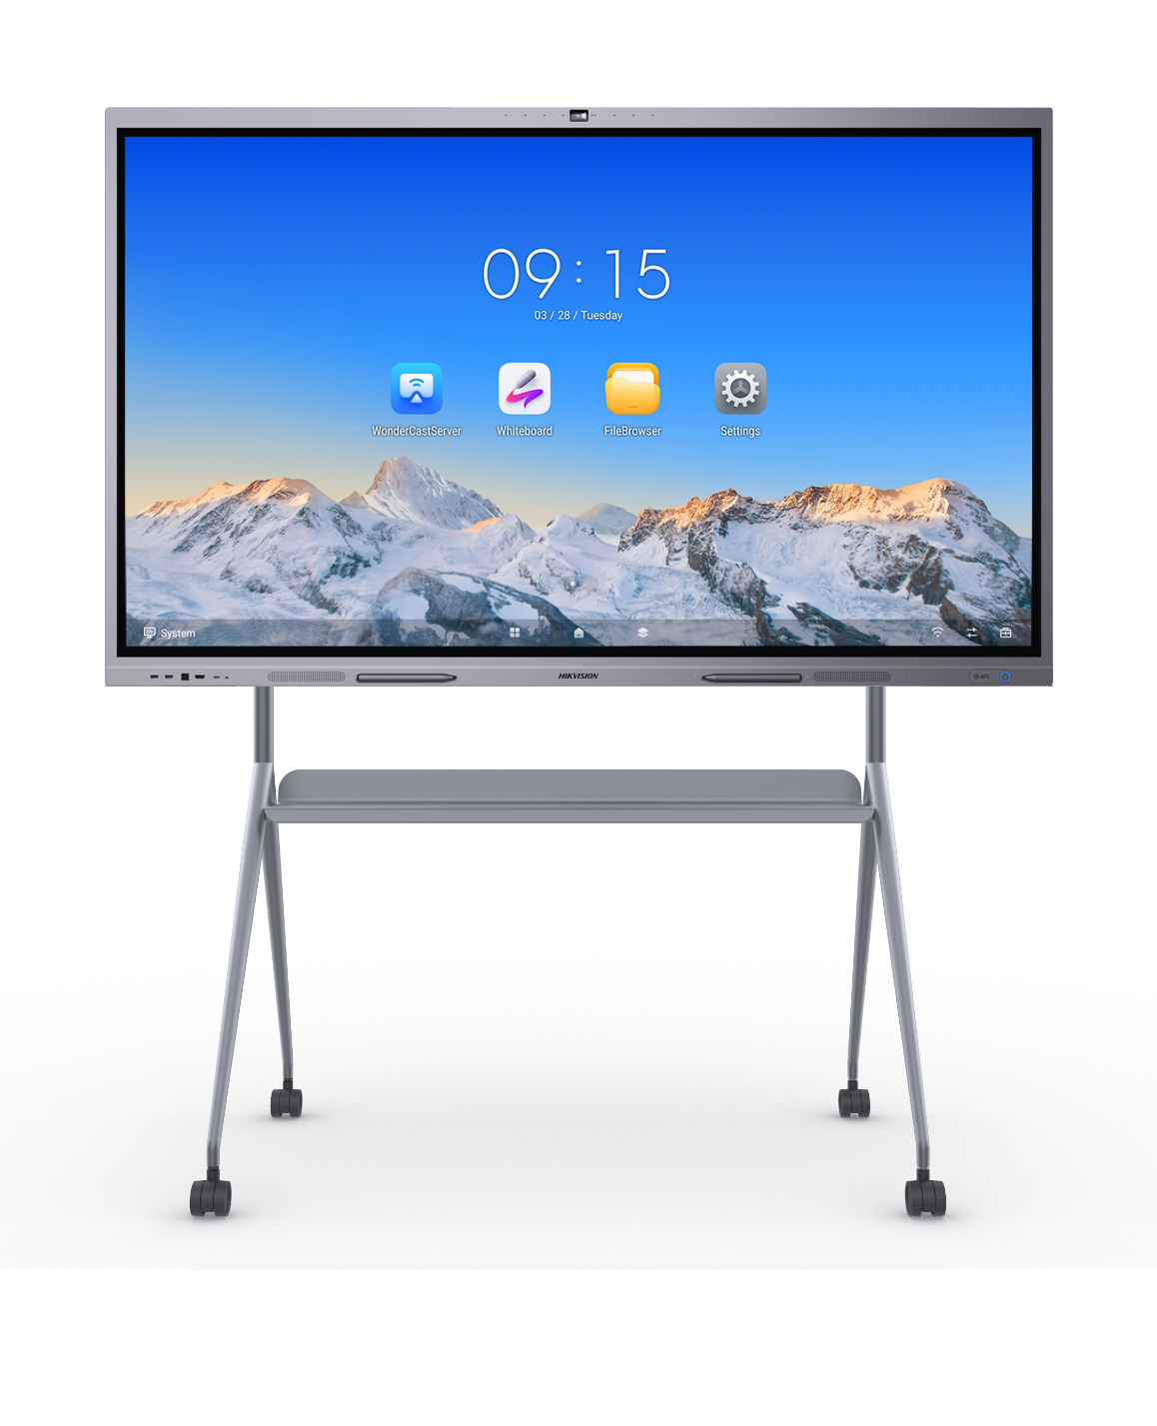
Advanced Industrial Design / täiustatud tööstusdisain?
Sisseehitatud kaamera ja mikrofon: Sisseehitatud 8MP kaamera ja 8-mikrofoniline massiiv, mis suudab heli kätte saada kuni 12m kauguselt
Elegantne välimus: Metallraami anodeerimine ja liivapritsitöötlus
Piisavad liidesed: 2*HDMI in, 1*HDMI out, 1*VGA In, 1*DP In, 1*Audio In, 1*Audio Out, 1*SPDIF Out, 2*TOUCH-USB, 2*USB 3.0, 1*USB 2.0, 1*Type-C, 1*RS232
Võimas riistvara ja süsteem: 8-core CPU, 8GB RAM + 128 GB ROM, Android 13.0
Esipaneeli liidesed: 1*HDMI in, 2*USB 3.0, 1* TOUCH-USB, 1*Type-C
NFC projektsiooni moodul: NFC projektsioonimoodul toetab Android-telefonide ühepuudutuselist edastamist
Sisseehitatud kõlarid: built-in 2*15W+ 25W loudspeakers
Paindlik paigaldus: toetab nii seinale kui ka põrandale paigaldamist
Notes:
Its metal surface is treated by anodizing and 150-mesh sandblasting, making its appearance beautiful and elegant.
For each terminal, we will give 2 pens for free, and there is a linear pen slot at the bottom. When finish using, users can just easily put the pen here, and it will be stuck here by magnetic, preventing pens from losing.

Slide 8






Outstanding Display
4K Resolutsioon
1,07 miljardit värvi, pildi detailide põhjalik taastamine.
4K
Peegeldusvastane klaas
Professionaalne peegeldusvastane töötlus, selgem ekraan, plekivastane, libisemisvastane, purunemiskindel ja sõrmejälgedevastane.
Optiline sinise valguse filtratsioon
Filtreerib üle 90% ultralühilainelisest sinisest valgusest, et kaitsta inimese silmi.
Tõkestab kahjulikku sinist valgust riistvara abil, kaitstes silmi ilma värvikõrvalekalleteta.
Conventional Anti-blue Light
Optical Anti-blue Light
Maailmatasemel paneel
Maailmatasemel DLED-tagantvalgustusega paneel, tagades peenema kuvamise ja ühtlasema heleduse.

Slide 9

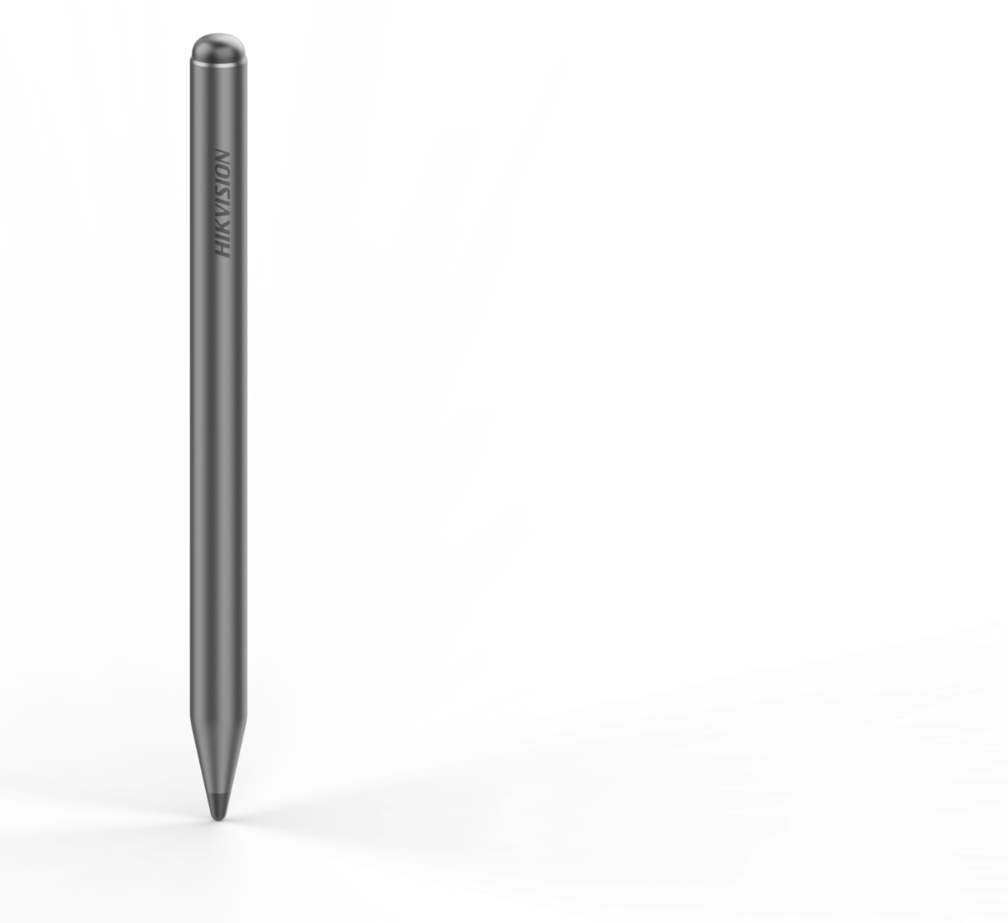
Specially Designed Writing Pen
Pliiatsi ots: PET värvimine, plekikindel.
Connector: 3-stage redundant-free structure, no assembly gap.
Logo: Must lasergraveeritud logo.
Pliiatsi välimus: Varihall pastakakere ja must pastakaots, sobitades kogu seadme värvi.
Kirjutamisots: Must TPU materjal, mustust tõrjuv, kvaliteetne kirjutamiskogemus ja hea kaitse kukkumise eest.
Two pens are included within the IFP’s package.
If customers require more pens, they can purchase separately.

Slide 10
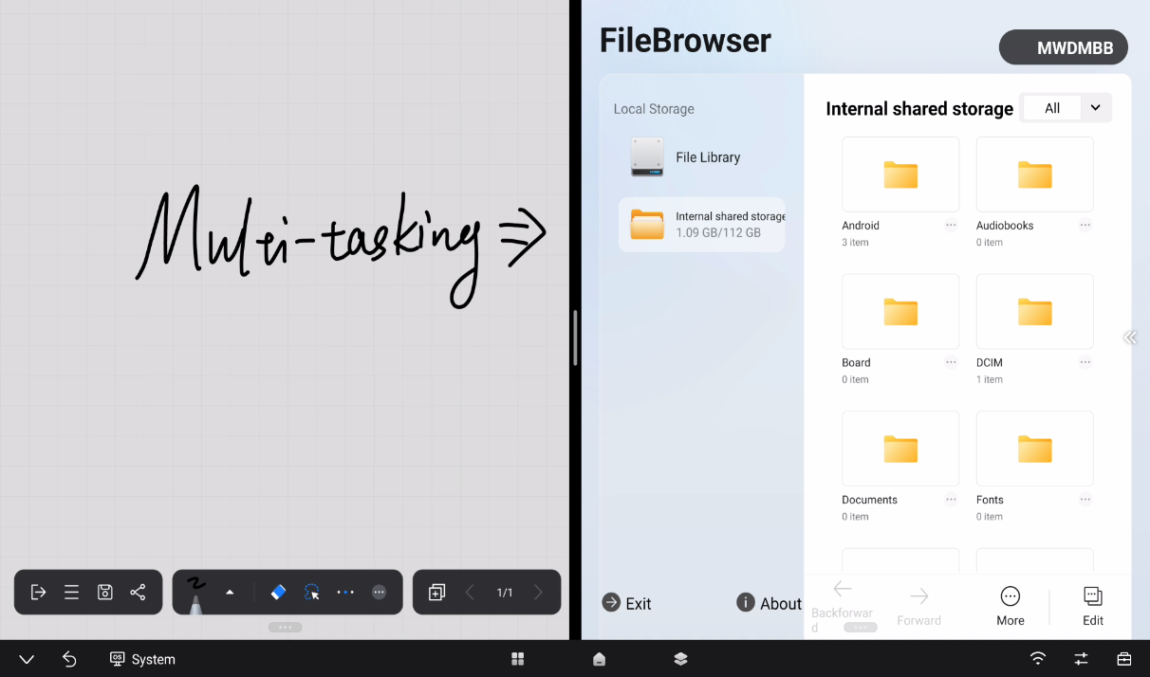
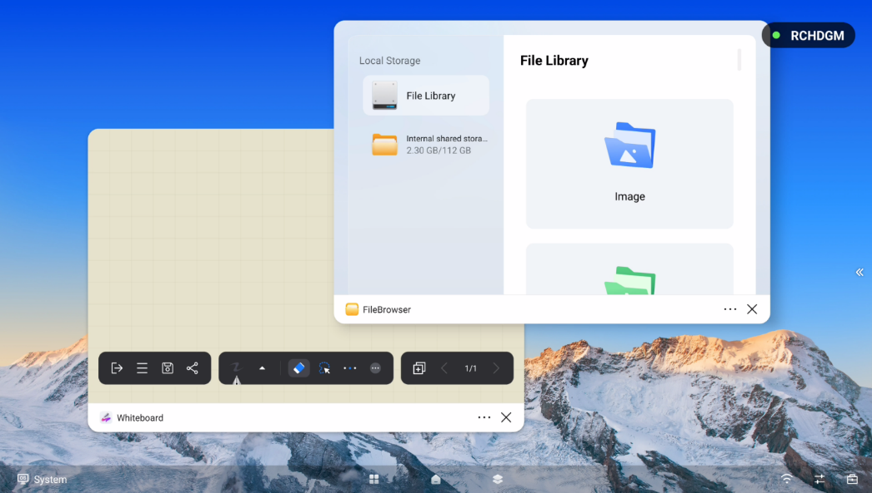
Multi-tasking Interfaces
Hikvision D5C seeria interaktiivsetel lameekraanidel on mitu ekraanirežiimi, mis võimaldavad mitme ülesande täitmist korraga.
Jagatud ekraanirežiim
Lubades kahe rakenduse kuvamist korraga
Mitmeaknarežiim
Lubades kuni 4 akna kuvamist korraga
Notes:
Hikvision D5C series IFP double screen split function. The screen can be split into two parts, each running its own different App.

Slide 11
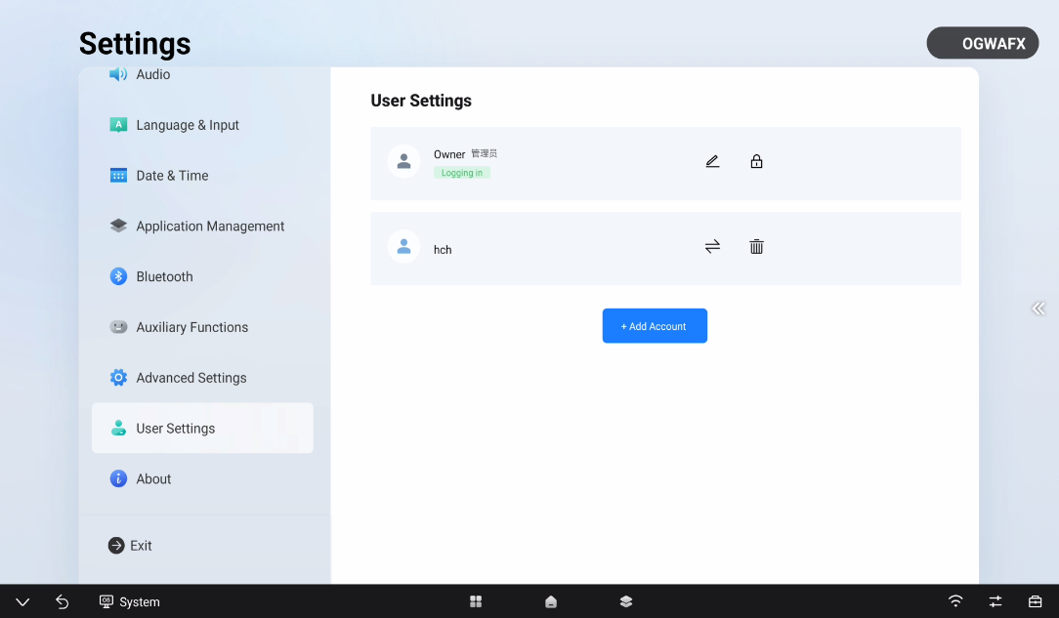
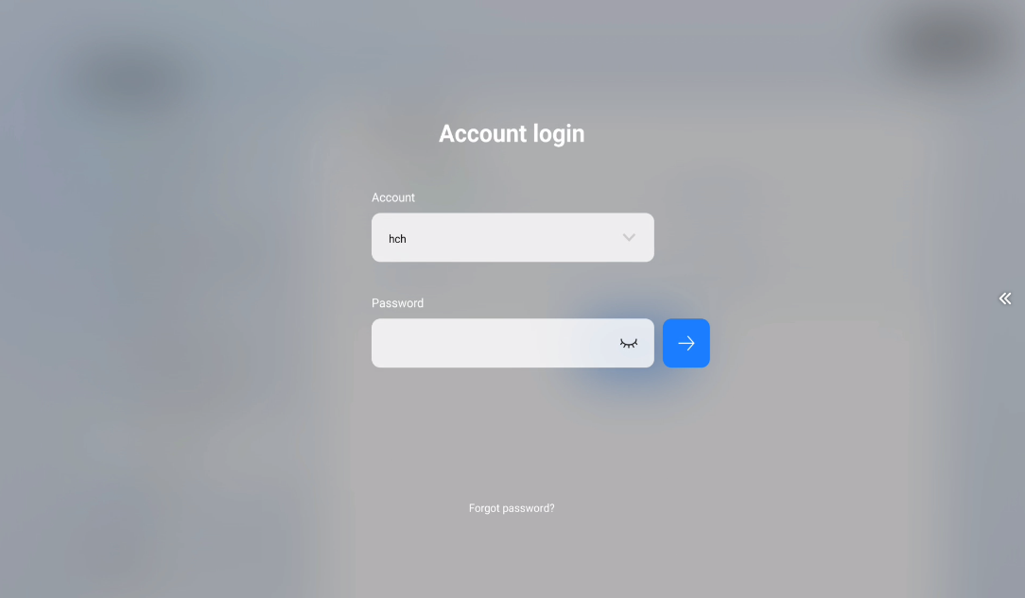
Multi-user Desktop
Avalike kasutusstsenaariumide jaoks pakub Hikvision D5C seeria mitme kasutaja töölaua funktsionaalsust. Kasutaja saab luua enda konto ja kohandada töölaua, keele ning rakendusi vastavalt oma vajadustele.
Logi sisse erineva kontoga
Keelte sätted, töölaua paigutus ning rakendused on kohaldatavad
Mitu kasutajat
Toetab kuni 10 kasutajakonto loomist
Note: The multi-user function of the D5C requires OTA to 3.1.0
Notes:
Hikvision D5C series IFP double screen split function. The screen can be split into two parts, each running its own different App.

Slide 12
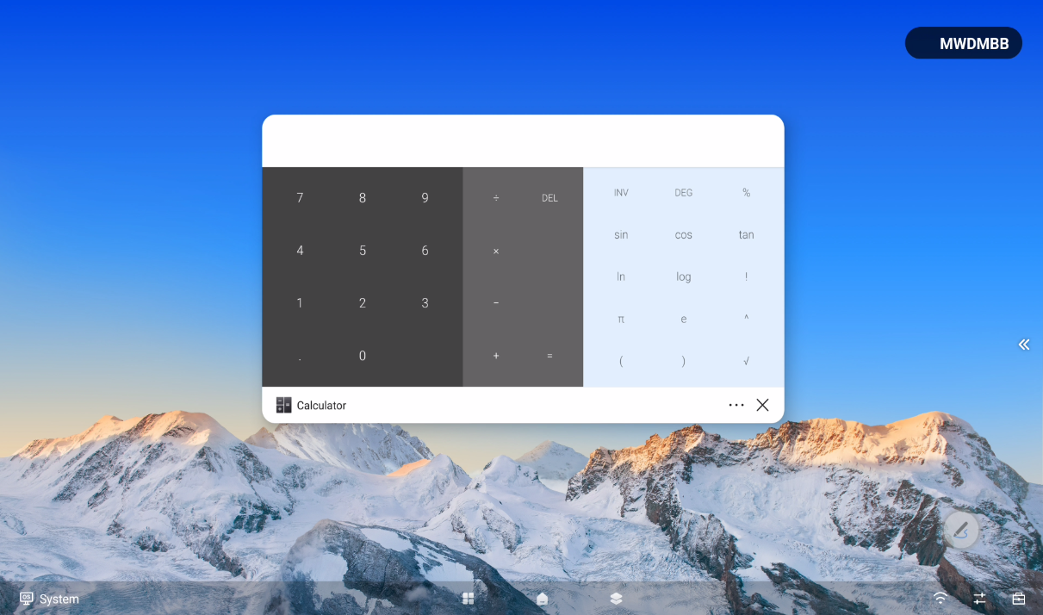
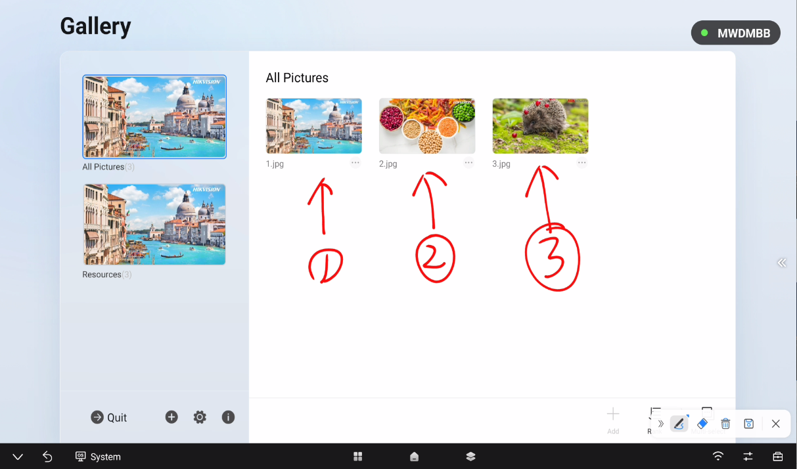

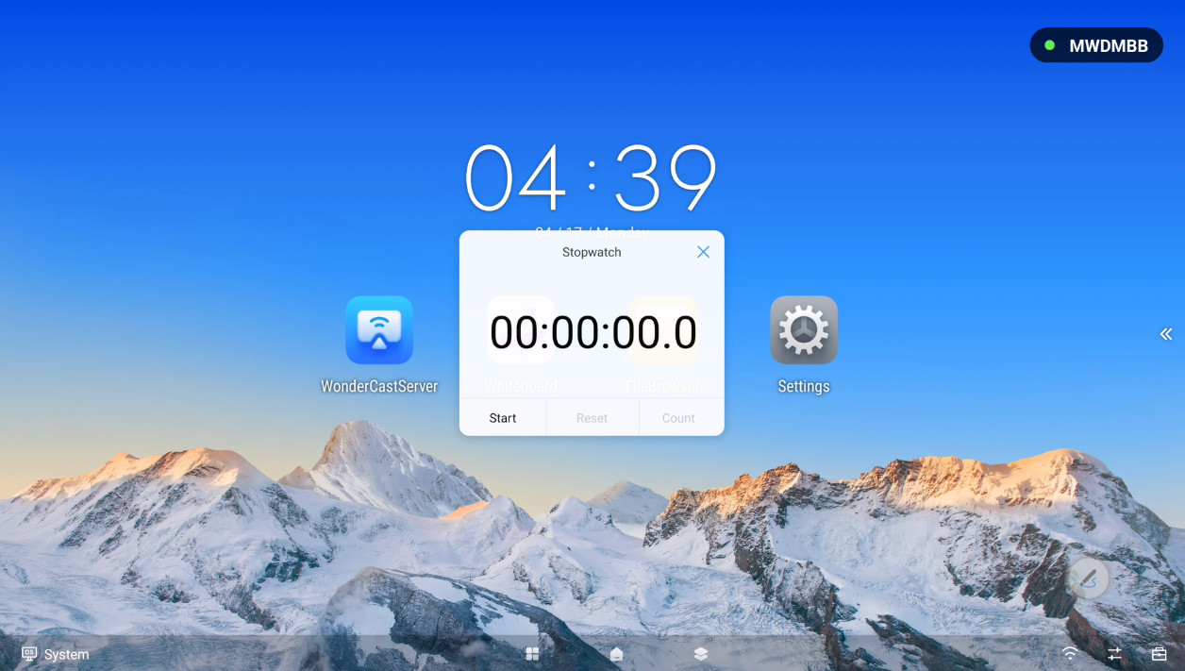
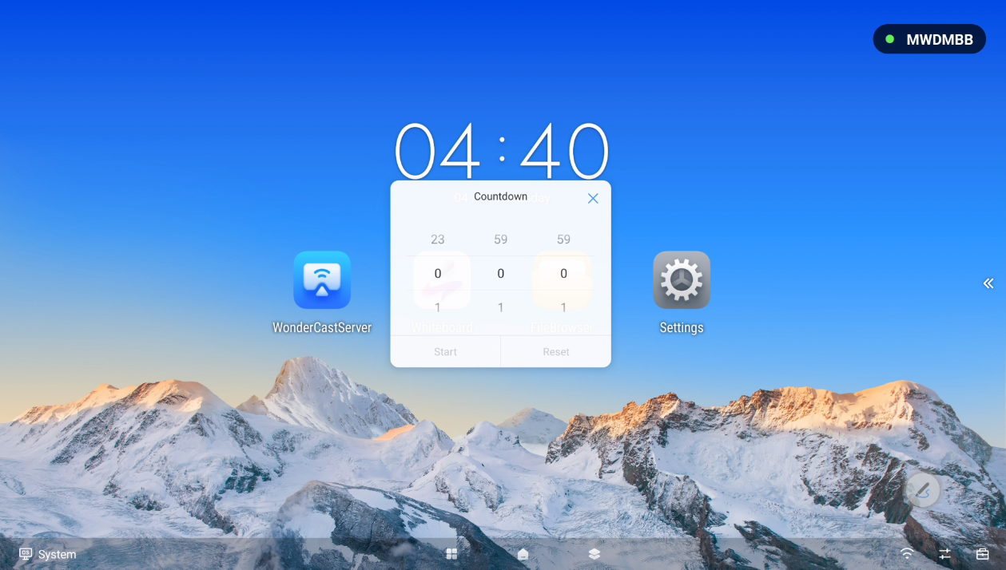
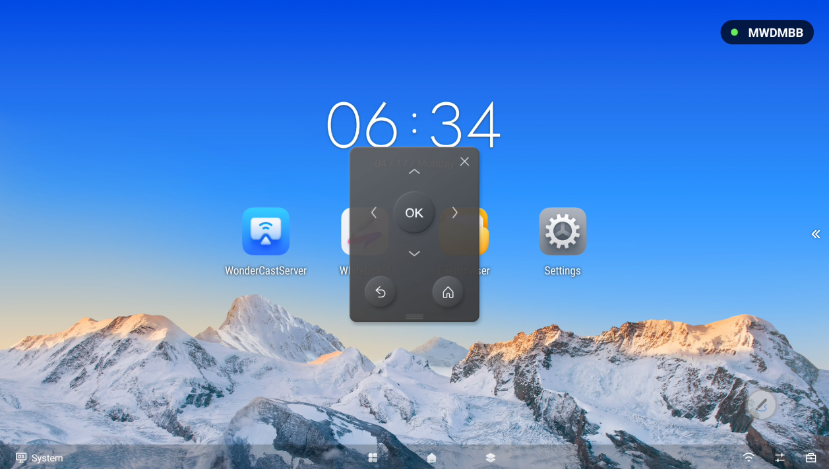
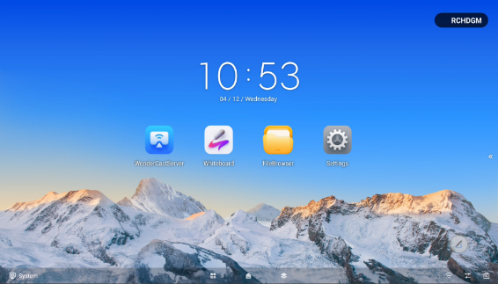
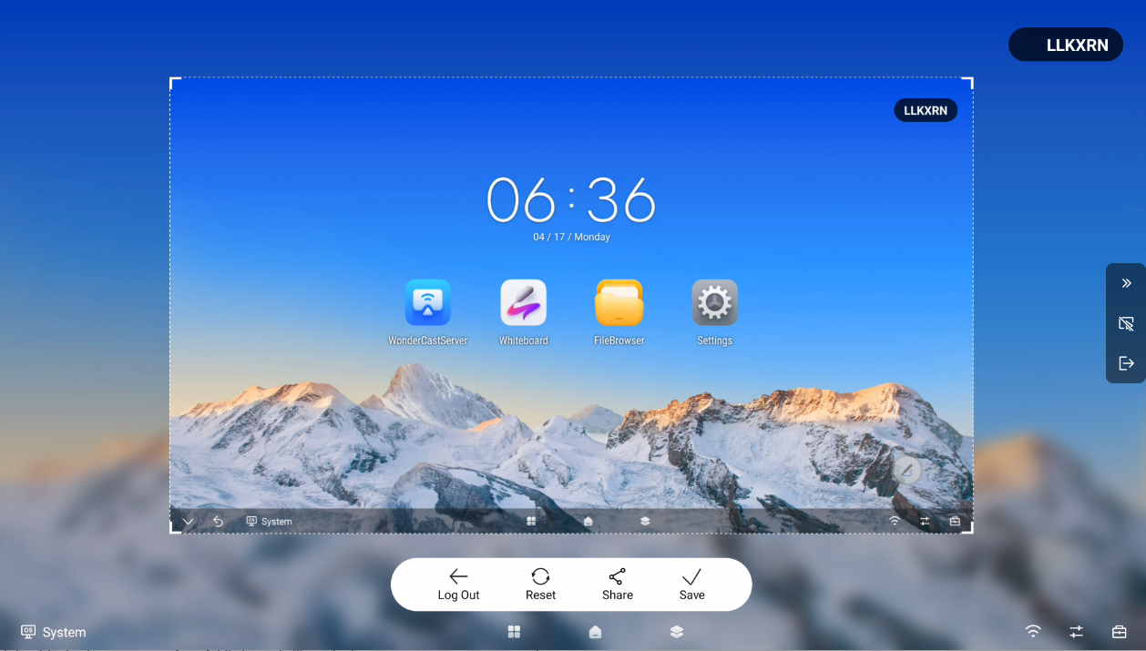

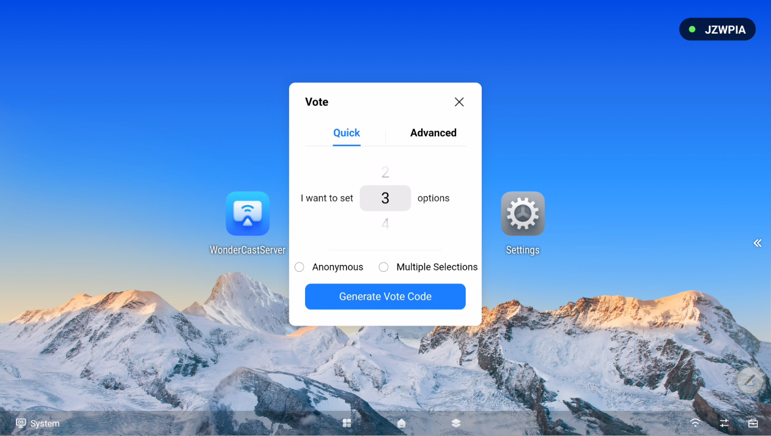
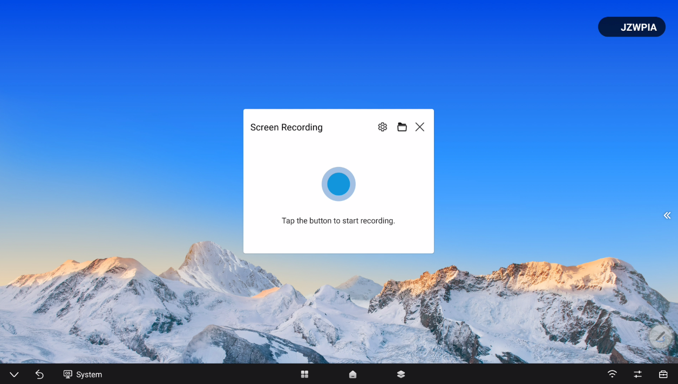
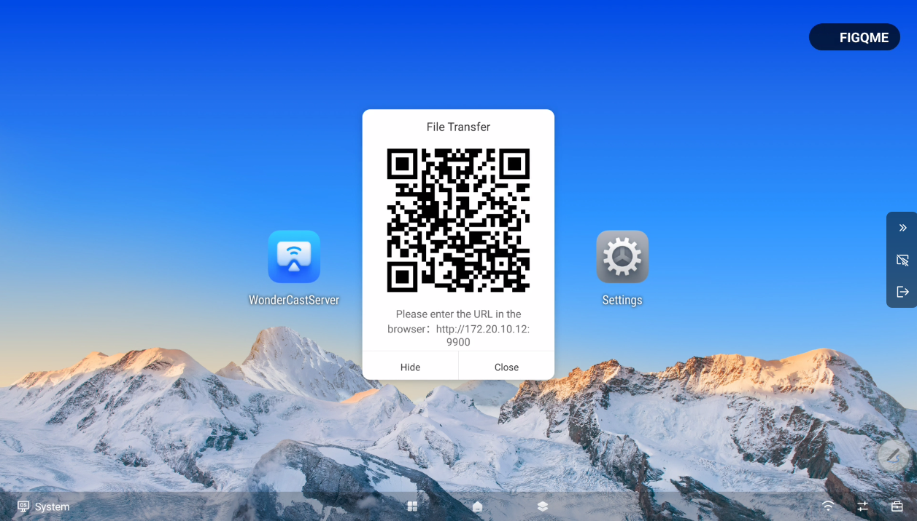
Useful Tools
Kalkulaator
Märkmete lisamine
Toetab märkmete lisamist igasuguses liideses
Kaamera
Saab teha pilte ja videoid
Stopper
Taimer
Juhtimispult
Virtuaalne kaugjuhtimispult
Lukustatud ekraan
Kuvatõmmis
Hääletamise tööriist
Hääletamiseks QR-koodi skaneerimine
Salvesti
Toetab video ja heli salvestamist
Failide saatmine
Failide saatmiseks QR-koodi skannimine
Hikvision D5C seeria IFP toetab 11 tüüpi sisseehitatud tööriistu, mis aitavad tõsta efektiivsust.
Notes:
On the bottom right side, it gives 8 types of useful little tools like calculator, note, camera, stopwatch etc.

Slide 13
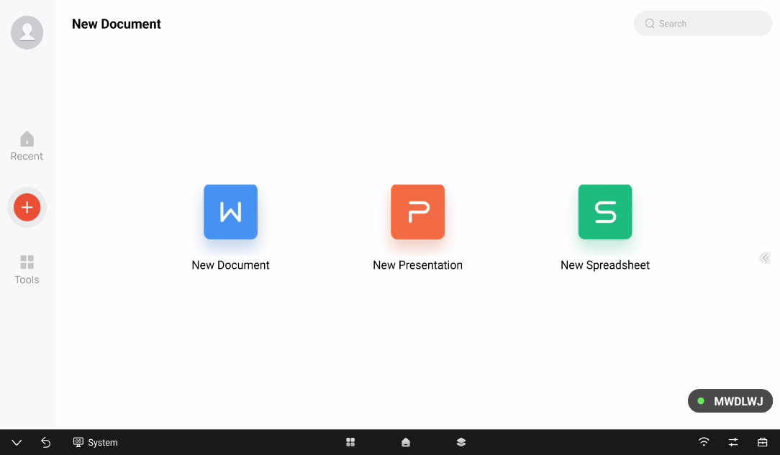
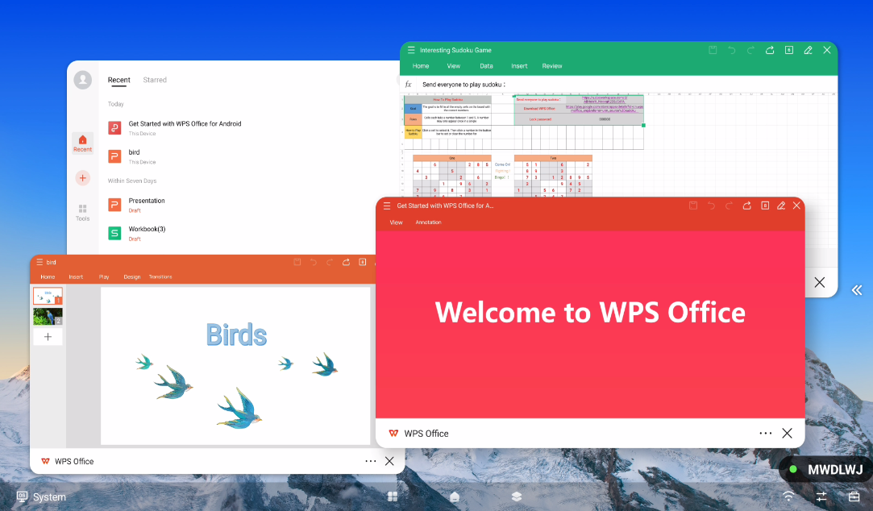
Pre-installed WPS Software
Iga IFP on eelinstallitud WPS tarkvaraga, mis on alatiseks tasuta. Kasutaja saab seda kasutada failide redigeerimiseks, nagu Word, Excel, PowerPoint ja PDF, täiesti tasuta.
Paindlik faili muutmine
Toetab Wordi, PowerPointi, Exceli ja PDF-i vaatamist ning redigeerimist.
Mitme-akna režiim
Kui avada WPS-i mitmeaknarežiimis, saab lõputult faile vaadata ja redigeerida samal ajal.
Notes:
On the bottom right side, it gives 8 types of useful little tools like calculator, note, camera, stopwatch etc.

Slide 14
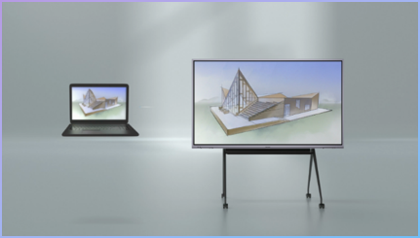
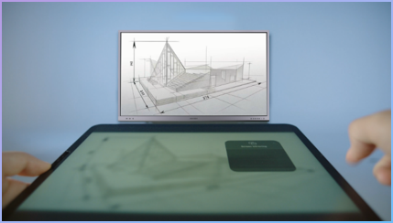
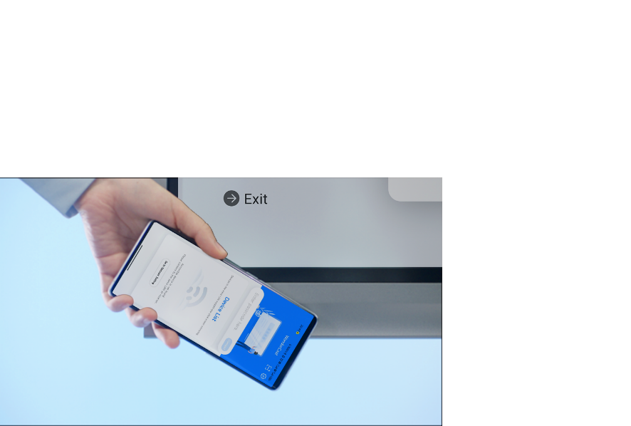
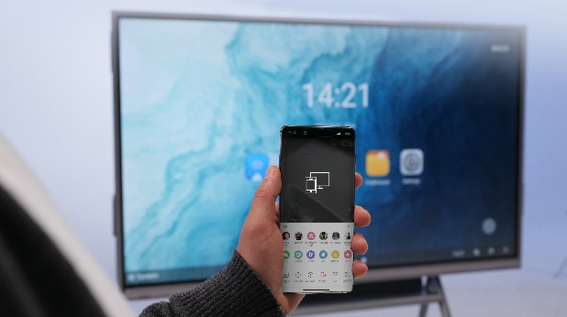
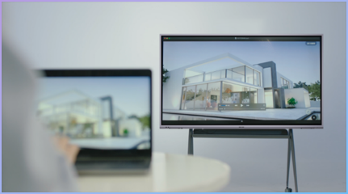
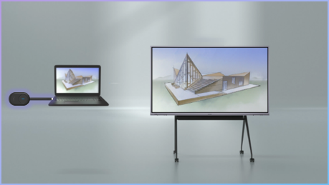
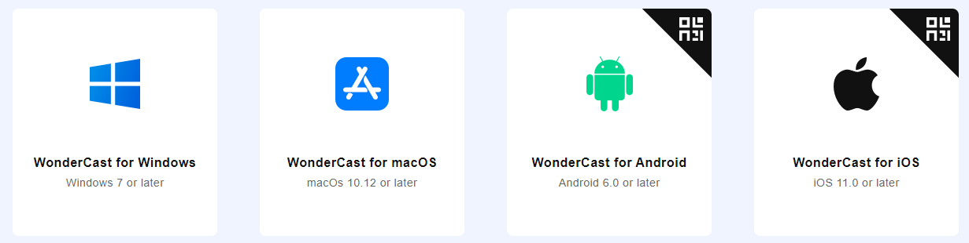
Easy Projection
Hikvisioni D5C seeria IFP toetab 6 projektsioonirežiimi, millest WiFi projektsioonirežiim läbi WonderCast'i pakub klientidele kõige arenenumaid projektsioonifunktsioone ja optimeeritud kogemust.
01- Kaabliga projektsioon
Kaabliga projektsioon HDMI ja esipaneeli tüüp-C sisendliideste kaudu.
02- AirPlay projektsioon
Otseprojektsioon AirPlay kaudu IOS-terminalidele.
03- NFC projektsioon
Toetab ühe puudutusega projektsiooni Android-telefonide kaudu.
04- DLNA projektsioon
Jagage sisu IFP-le, samal ajal vabalt opereerides isiklike seadmetega.
Visit www.hikvision.com/en/wondercast to download WonderCast for Wi-Fi projection
Input projection code to start projection instantly at up to 4K@30fps.
Supports more advanced projection functions: expansion mode, simultaneous projection, reverse control, and reverse projection, etc.
05- Wi-Fi projektsioon
06- Dongle projektsioon
Kasutades traadita projektsiooni donglit
Notes:
Hikvision D5C series IFP provides 3 ways of projection: cable projection, AirPlay projection and Wi-Fi projection.
Cable projection is the most traditional projection mode. Apart form the most commonly used HDMI cable based projection, the D5C series IFP also allow users to conduct very easy and convenient cable projection via the Type-C interface on the front side.
For IOS devices like iPhone and iPad, users can do projection directly via the built-in AirPlay function. No need to install any software, just do it via the drop down menu.
And the most frequently used, and most recommended projection method is Wi-Fi projection. Users need to download a free software named WonderCast, which is available for PC, Mac, Android and IOS.

Slide 15
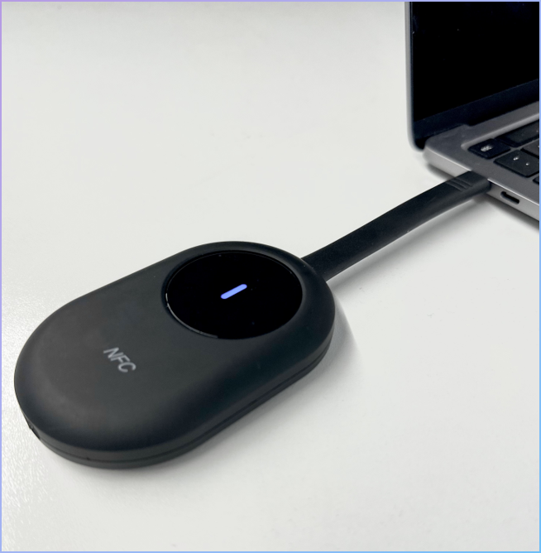

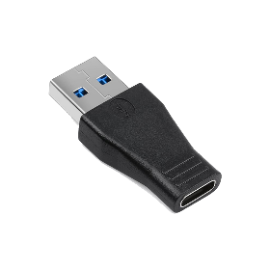


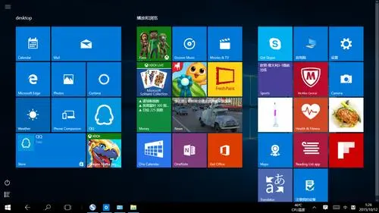


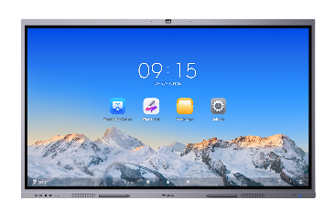

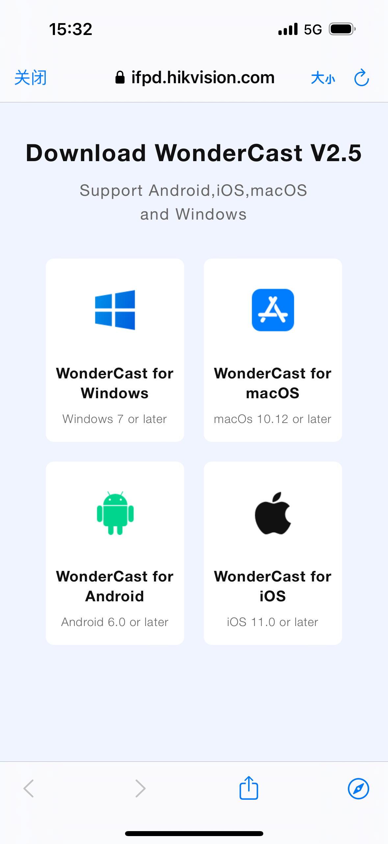

Easy Projection- Dongle Projection
Dongelprojektsioon on lihtsam alternatiiv WiFi projektsioonile. See on ühilduv Windowsi PC-de, Maci ja Android-telefonidega. Pole vaja sisestada projektsioonikoodi, lihtsa ühendamisega saate nautida kuni 4K 30 kaadrit sekundis videokvaliteeti. Ideaalne esmakordsetele külastajatele, kes tulevad koosolekule.
Main Components
Projection Process
For PC and Mac
Type-C to USB
Adapter
Type-C Plug
01- Ühendage dongel IFP-ga.
02- Kui ühildumine on õnnestunud, ühendage dongel arvutiga.
03- Alustage pildi ülekandmist ekraanile
For Android Phone
Start/Stop projektsiooni nupp
NFC moodul
Type-C laadimine
01- Installige WonderCast rakendus ja ühendage IFP-i mobiilse interneti levialaga.
02- Asetage dongel mobiiltelefoni alla.
03- Alustage pildi ülekandmist ekraanile
Märkus - Kui PC/Mac on dongliga esmakordselt ühendatud, tuleb sellele donglist installeerida ScreenCast plugin.

Slide 16

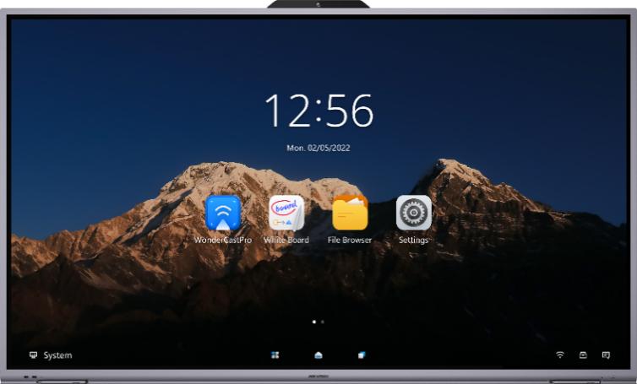




Easy Projection- Wi-Fi and Dongle Projection
Dubleerimisrežiim
IFP näitab sama sisu kui signaaliallikas.
Laiaekraanirežiim
IFP kasutamiseks signaaliallikale lisakuvari.
BYOM
Toetab traadita BYOM-funktsiooni, PC-l toimuval koosolekul saab otse kasutada IFP kaamerat ja mikrofoni.
Märkus - WonderCast peaks uuendama versioonile 2.9.0, et toetada BYOM funktsiooni.
Notes:
It supports two projection modes: duplication mode and extension mode. Duplication mode means to duplicate your screen to the IFP, showing the same content, while extension mode means to use the IFP as an auxiliary screen. So when working at extension mode, you can show one thing on your laptop, and show another thing on the IFP, which can help to protect your privacy.

Slide 17
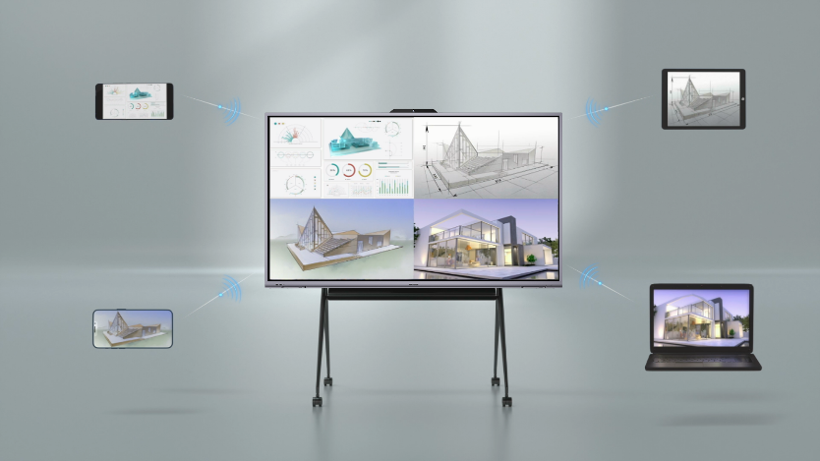
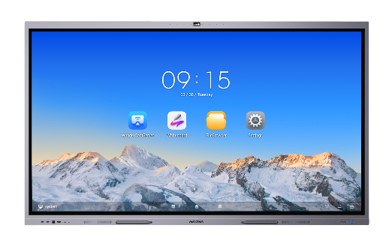


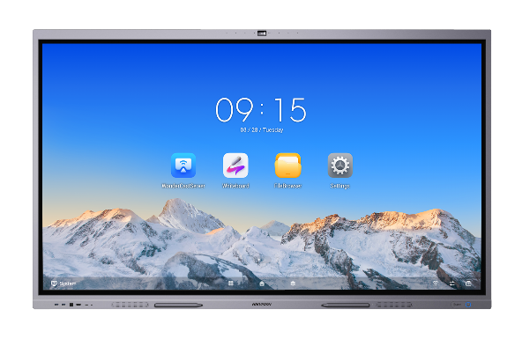

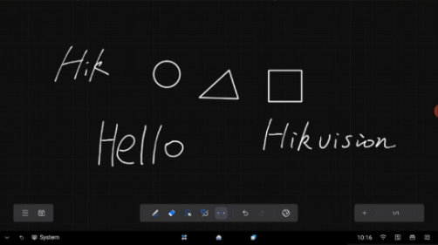
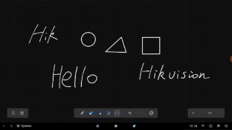



Easy Projection- Wi-Fi and Dongle Projection
Simultaneous Projection
Supports up to 4 signal sources simultaneous projection.
Reverse Control
For PC and Mac, while projecting, users can use the IFP’s touch screen to control the signal source.
Projection
Control the computer by IFP’s touch screen
Signal Source
Reverse Projection
Use the IFP as signal source, to project its view to the computer/mobile phone.
Wi-Fi AP & STA Mode
The IFP can work at AP and STA mode at the same time.
Projection
Control
AP Mode
STA Mode
AP Mode and STA Mode
Signal Source
Note- Dongle projection doesn’t support reverse projection
Notes:
For PC projection, you can use the IFP's touch screen to directly control the PC reversely.
D5C series IFP supports up to 4 signal sources projecting simultaneously. This function is very useful for conference, because multiple people they can project their screens to the IFP at the same time, for easy idea sharing and discussion.
Our IFP supports Bluetooth 5.0 and Wi-Fi 5.0. For Wi-Fi 5.0, it can work at AT and STA mode at the same time, making it rather convenient for Wi-Fi projection because it can either be the mobile phone connecting to the IFP's hotspot, or the the mobile phone and the IFP connecting to the same environment Wi-Fi.

Slide 18
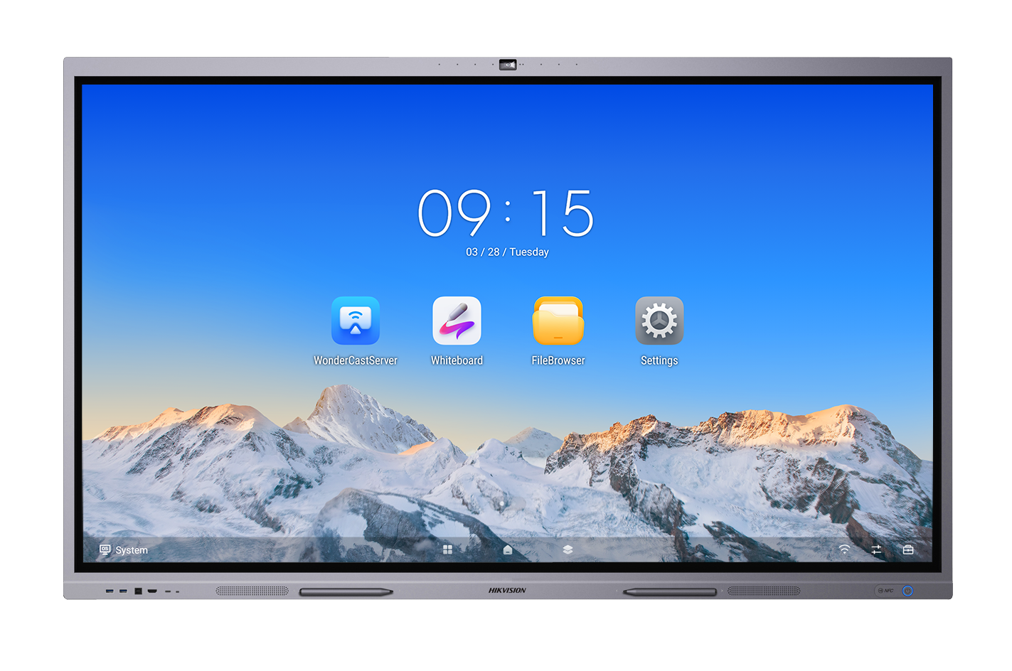
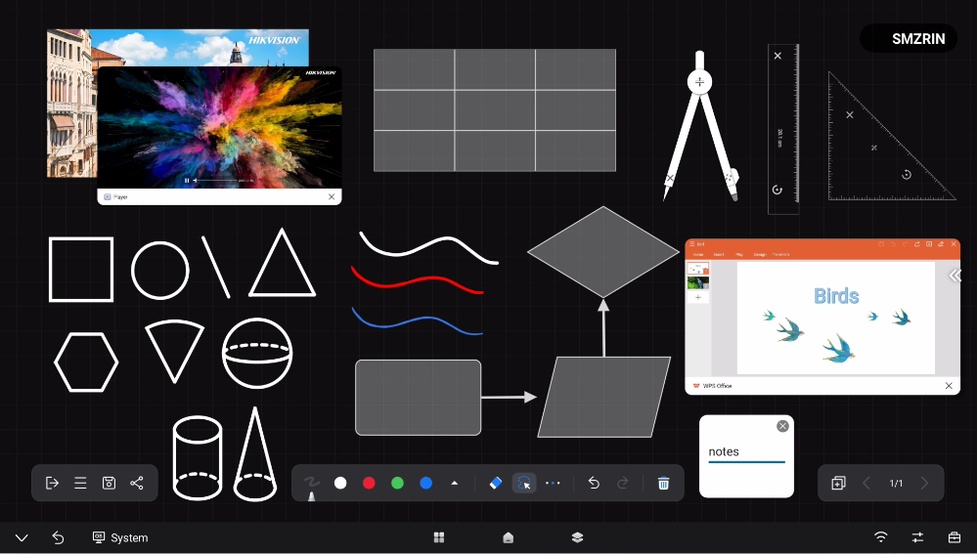
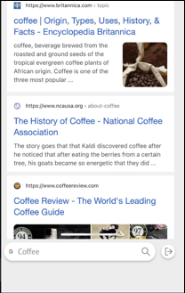


Digitaalne tahvel
Lisa pilte ja videoid
Joonistamine: toetab 3 tüüpi pintsleid ja kohandatavaid värve/paksust
Sisesta tabeleid ja jooniseid
Kompassi, joonlaua, kolmnurkse joonlaua ja sirkli lisamine
Note: The ruler function requires OTA to 3.1.0
Sisseehitatud brauser toetab pildi importimist kanvasse
Kohandatav taustavärv/pilt
Lisage 9 kuju: ring, ristkülik, kolmnurk, joon, kuusnurk, kera, silinder, and koonus
Note: The shape function requires OTA to 3.1.0
Lisa PPT, PDF, word ja excel
Note: Inserting file function requires OTA to 3.1.0
Lisa märkmeid
45-punktiline IR-puuteekraan
- Võimaldab mitmel inimesel samal ajal kirjutada.
Mohs level 7 hardness glass
Not easy to leave scratches and finger prints.
Notes:
Now let's see the whiteboard. Hikvision D5C series IFP provides users with a very powerful and friendly whiteboard for you to write and draw, and share your ideas.
Here we click the icon to open it.
This is the UI of the whitebard. You can either use the pens, or your fingers or anything else to write on it. We support 3 types of brushes, and users can adjust the bursh color and thickness freely.
A very cool function is that our whiteboard supports dual-color writing. When working with the accessory pen, users can write one color by the pen's one end, and another color by the other end.
You can insert pictures, table, shapes and flow charts to the whiteboard easily here. And one more very powerful thing is that, the whiteboard supports a built-in website searching window. Clikc here, and on the right side it will show the Google search engine. So no need to switch to the brower App, you can just search the Internet here. And if you find some good pictures in the search result, you can directly drag it to the whiteboard.

Slide 19

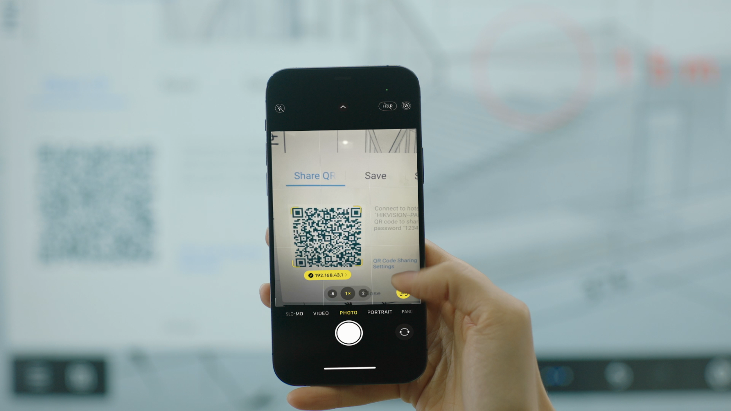
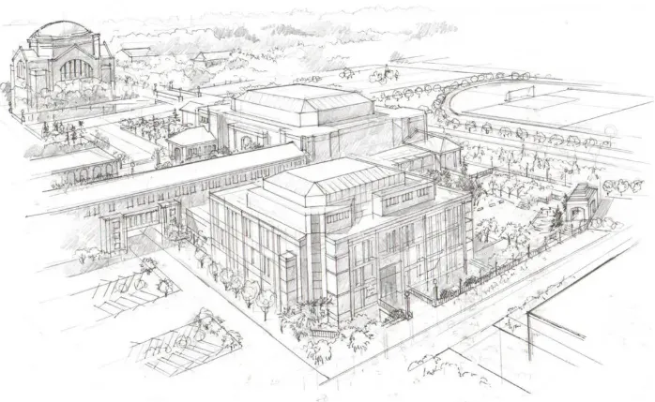
Digital White Board
Tahvli salvestamine
Toetab 3 viisi valgetahvli tulemuse salvestamiseks: salvesta pildina, PDF-ina ja VWB-failina. Jagamine QR-koodi ja e-posti teel.
Kahevärviline kirjutamine
Toetab kirjutamist kahe erineva värviga pastaka kahe otsaga.
Pen tip
Pen end
Notes:
And when you finish your job on the whiteboard, how to save the screenshot? We provide 3 methods. Either to send by email, or save to USB disk, or the most convenient way, to save to your mobile phone via QR code.

Slide 20

Digital White Board
Mustrite tuvastus
Toetab kolme kuju mustrituvastust: ring, kolmnurk ja ristkülik
Tähemärkide tuvastamine
Toetab ingliskeelse, hiina (lihtsustatud), numbrite ja kirjavahemärkide tähemärkide tuvastamist.
STAR
Notes:
There are 2 smart functions in our whiteboard. One is pattern recognition. The system can help you to transfer the shapes of circle, triangle and rectangle to be standard shapes.
The other is character recognition function. It can recognize Chinese and English. When you write a word on the whiteboard, it will transfer it to standard fonts automatically. And these two smart functions you can choose whether to turn it on or off.

Slide 21

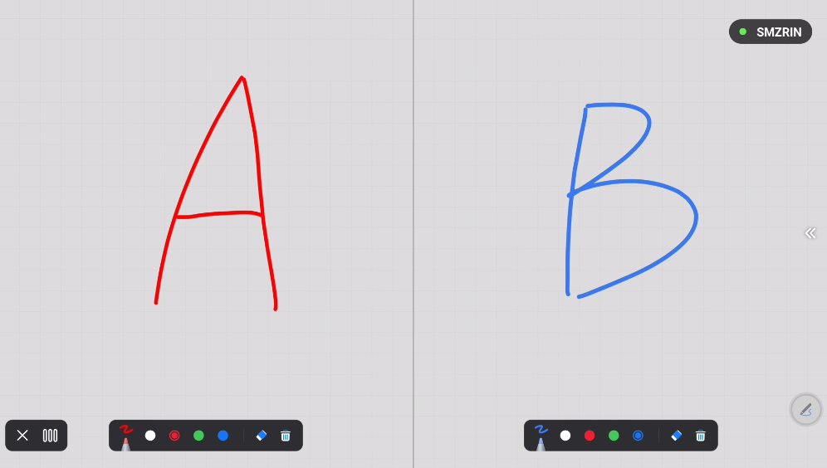
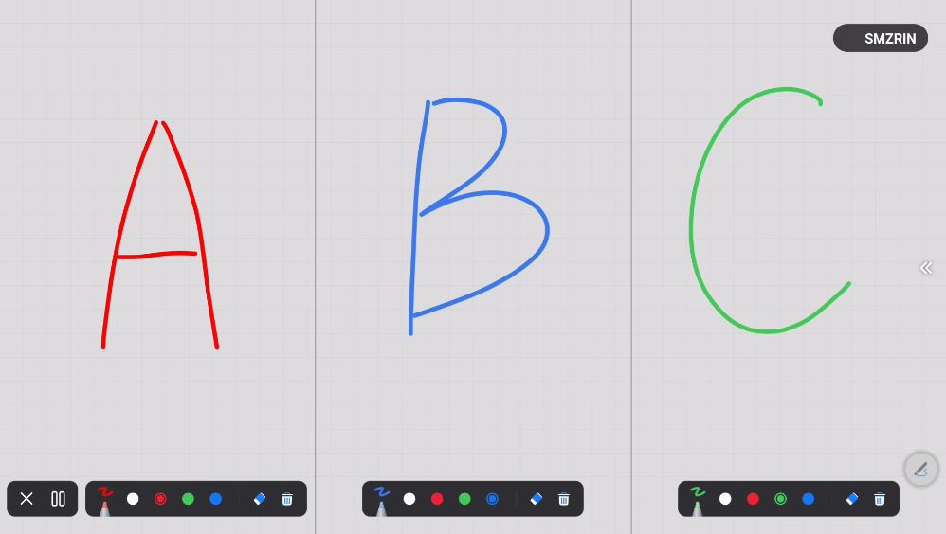
Digital White Board
Jagatud ekraanikirjutamise režiim
Toetab jagatud ekraanikirjutamist klassisiseseks koostööks;
2 kuni 3 õpilast saavad kirjutada individuaalsetel tsoonidel, üksteist segamata
Kaheks jagatud ekraanivaade
Kolmeks jagatud ekraanivaade
Note: The split-screen function of the D5C requires OTA to 3.1.0
Notes:
There are 2 smart functions in our whiteboard. One is pattern recognition. The system can help you to transfer the shapes of circle, triangle and rectangle to be standard shapes.
The other is character recognition function. It can recognize Chinese and English. When you write a word on the whiteboard, it will transfer it to standard fonts automatically. And these two smart functions you can choose whether to turn it on or off.

Slide 22


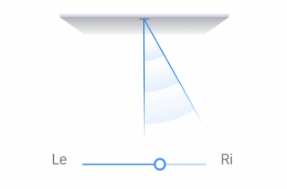
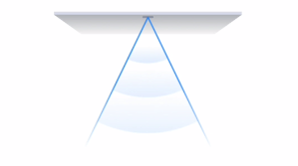






Intelligent Built-in Camera and Mic
Acoustic Baffle
Can filter the external noises outside the baffle. (below image is top view)
Personal Mode
Only pick up the sound within the 30° range, the direction is adjustable
Meeting Mode
Pick up the sound within the 60° range, the direction is fixed
Sisseehitatud 8MP resolutsiooniga kaamera ja
8-mikrofonimassiiv
Automaatne kaadrisättimine
Reguleerige vaadet automaatselt, et näidata kõiki osalejaid ekraanil.
Kõneleja jälitamine
Automaatne suumimine, et näidata hetkelist kõnelejat.
Notes:
The built-in camera is a big highlight of the terminal.
Its 8MP super high resolution and with rotation function to protect privacy.
Here are two smart functions.
The auto framing function means that, the camera can automatically adjust its view to show all people on the screen.
And the speaker track function means that the camera can zoom automatically to the speaker.
Please not that these two smart functions are mutual exclusion. User can only activate one of them at one time.

Slide 23












Remote Video Conference
OPS
OPS Slot
Insert OPS
OPS on oluline kaugvideo konverentsilahenduse jaoks. Mis tahes kaugkoosoleku tarkvara sobib, pole piiratud ainult Zoomiga.

Slide 24






Product Showcase
Model | DS-D5C65RB/A | DS-D5C75RB/A | DS-D5C86RB/A | DS-D5C65RB/B | DS-D5C75RB/B | DS-D5C86RB/B
Image
Diagonal Size | 65" | 75" | 86" | 65" | 75" | 86"
Resolution | 3,840 × 2,160 @60 Hz
Contrast Ratio | 5,000:1
Brightness | 400 nits
Response Time | 8ms
Touch Response Time | < 10ms
System | Android 13.0
CPU | Quad-core Cortex-A76 and quad-core Cortex-A55
RAM&ROM | 8 + 128 GB
Projection | Cable (HDMI + Type-C), Wi-Fi, AirPlay, NFC, DLNA, Projection Dongle
Interfaces | HDMI In × 3, VGA In x 1, DP In x 1, Audio In x 1, HDMI Out x 1, Audio Out x 1, SPDIF Out x1, TOUCH-USB × 3, RS232 × 1, USB 3.0 × 4, USB 2.0 × 1, Type-C x 2
Built-in Loudspeaker | Built-in 2 ×15 W+25W loudspeaker
IR Touch Points | 45
Built-in Camera | No |  |  | 48MP for photos, 8MP for videos
Built-in Microphone | No |  |  | 8 Microphone Array
Notes:
For D5C series IFP, we have 3 sizes available: 65", 75" and 86", suitable for different meeting room or classroom sizes.

Slide 25




Comparison Between /A and /B Series
Built-in Camera
8-microphone array
DS-D5CxxRB/A
(ilma sisse-ehitatud kaamerata ja mikrofonita)
DS-D5CxxRB/B
Built-in 8-microphone Array
Specification: Omni-directional 8-microphone array
Function: Echo reduction and smart noise-cancellation
Sound-pickup Distance: 12m
Sampling Rate: 32K
Mic Sampling Rate: 16bit
Built-in Camera
Resolution: 48MP for photos, 8MP for videos
Function: Smart switch between Android and OPS
FoV: 120 °(diagonal), 110°(horizontal), 75°(vertical)
Distortion: ≤2.5%
Notes:
For /D models, there is a 8-MP built-in camera and a 6-array built-in microphone on the top, while /C models are without them. So If customers want to do remote conference solution, they'd better purchase the /D models.

Slide 26


Accessories
Bracket
OPS
11th-generation Intel® Core i5 3.2 GHz
Memory 8GB, SSD 256GB
Intel® Iris® Xe Graphics, support 4K resolution
Support M.2 nvme system disk quick start
Support 3 USB 3.0 ports, 3 USB2.0 ports, 1 HDMI port, 1 DP interface，1 Type-C port
Support dual channel memory
Support Wi-Fi IEEE 802.11 a/b/g/n/ac
Built-in WIN 10 SAC
11th-generation Intel® Core i7 2.8 GHz
Memory 16GB, SSD 512GB
Intel® Iris® Xe Graphics, support 4K resolution
Support M.2 nvme system disk quick start
Support 3 USB 3.0 ports, 3 USB2.0 ports, 1 HDMI port, 1 DP interface，1 Type-C port
Support dual channel memory
Support Wi-Fi IEEE 802.11 a/b/g/n/ac
Built-in WIN 10 SAC
DS-D5ABKY2-B
Suitable for 86” model
Silver gray, SPCC high quality steel plate
Sheet metal spraying
DS-D5AC11T5-8S2
DS-D5ABKY2-S
Suitable for 65/75” model
Silver gray, SPCC high quality steel plate
Sheet metal spraying
DS-D5AC11T7-16S5
Note: wall-mounted bracket is included in the package by default.
Omnidirectional Microphone
Adopts 8-mic array, picking up 360° clear sound with 5 meters range
Adopts the HD speaker
Supports steady and transient smart noise reduction, echo and squeal suppression, anti-reverberation to enhance speech quality and offer audio in high quality
Compatible with leading online conferencing platform
DS-UAC-S1V (Wired）
DS-UAC-S1 (Wireless）

Slide 27

03
Related Solutions
Large Meeting Room Solution
Central Management Solution
Remote Education Solution
Hybrid Education Solution
Group Discussion Solution

Slide 28






3.1 Large Meeting Rooms- Group Display Solution
Hikvision D5B seeria IFPD toetab grupiekraani funktsiooni. Kasutades WonderCast grupiekraani funktsiooni, saavad kasutajad luua kuni 4 IFPD, mis projitseerivad üheaegselt traadita suurema ala katmiseks.
Main Screen
Wi-Fi Projection
Group Display
Group Display
Group Screen
Group Screen
Group Display
up to 4 IFPDs simultaneous projection
Group Screen

Slide 29








3.2 Central Management Solution
HikCentral FocSigni abil saavad kasutajad hallata kuni 2048 terminali kaugelt, muutes mitme asukoha keskse haldamise üsna lihtsaks.
Room N
Room N
…
…
Room 2
Room 2
Operator
HikCentral FocSign
Switch
Room 1
Room 1
Control Room
Building A
Building B
…
Remote Batch Power Off
Remote Batch App Installation
Remote Batch Image
Remote Batch Firmware Upgrade
Remote Batch Message
Remote Batch Video
Note: The new function of the D5B requires OTA to 2.5.0
Notes:
Imagine there is a big school or campus, and there are many IFPs deployed in different buildings and rooms. How to manage them remotely and centrally? We have a free software named HikCentral FocSign. This software can accomplish this task. Here in my laptop I already install one. In this software, users can remote batch power off the IFPs to save power in case some terminals may be left running continuously, to remote batch install Apps, and to send text message remotely in case of emergency. One single platform can manage up to 1,024 IFPs.

Slide 30

THANKS
Clear Video, Always Delivered

